Slide 1
Review quizzes
What is kernel trick?
If we increase the margin from very tiny to a moderate size,
the training error tends to increase or decrease?
the test error tends to increase or decrease?
What is the difference between linear SVM and logistic regression?
What is the difference between linear SVM and SVM with linear kernel?
Compare SVM with polynomial kernel and linear model using poly-2 feature engineering, what are their advantages and disadvantages?

Slide 2
Road map of how we derived SVM
Maxmize margin with inequality constraints
Can be modeled in primal form
Can be solved by standard QP solvers
Introducing kernel functions to map features into higher (could be infinite) dimension
Difficult (could be impossible) to solve when modeled in primal form
SVM follows certain properties such that solving dual form equivalents to solvig primal form
Dual form can be solved by standard QP solvers, even if kernel functions map features to infinite dimensional

Slide 3
Generating ROC Curve is expensive?
Some students said that generating the ROC curve is expensive
Yes, it is expensive compared to computing, for example, accuracy. If we have n test instances, we will need O(n) thresholds
However, only need to go through all the training instances once, i.e., the complexity is O(n)
So it is not as expensive as some students thought

Slide 4
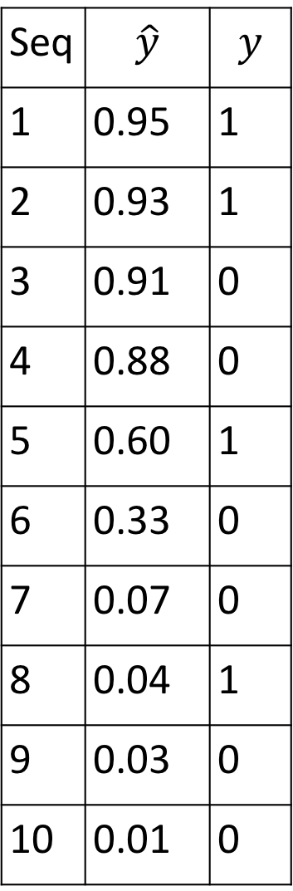
How to generate the ROC curve
Seq | $$\hat{y}$$ | $$y$$
1 | 0.95 | 1
2 | 0.93 | 1
3 | 0.91 | 0
4 | 0.88 | 0
5 | 0.60 | 1
6 | 0.33 | 0
7 | 0.07 | 0
8 | 0.04 | 1
9 | 0.03 | 0
10 | 0.01 | 0
←TP=0, FP=0, so TPR=0/4; FPR=0/6
←TP=1, FP=0, so TPR=1/4; FPR=0/6
←TP=2, FP=0, so TPR=2/4; FPR=0/6
←TP=2, FP=1, so TPR=2/4; FPR=1/6
←TP=2, FP=2, so TPR=2/4; FPR=2/6
←TP=3, FP=2, so TPR=3/4; FPR=2/6
←TP=3, FP=3, so TPR=3/4; FPR=3/6
←TP=3, FP=4, so TPR=3/4; FPR=4/6
←TP=4, FP=4, so TPR=4/4; FPR=4/6
←TP=4, FP=5, so TPR=4/4; FPR=5/6
←TP=4, FP=6, so TPR=4/4; FPR=6/6

Slide 5
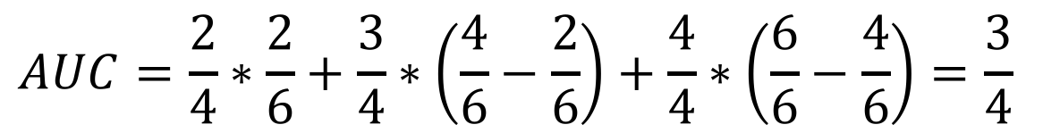
Plotting the ROC curve
TPR | FPR
0/4 | 0/6
1/4 | 0/6
2/4 | 0/6
2/4 | 1/6
2/4 | 2/6
3/4 | 2/6
3/4 | 3/6
3/4 | 4/6
4/4 | 4/6
4/4 | 5/6
4/4 | 6/6
Seq | $$\hat{y}$$ | $$y$$
1 | 0.95 | 1
2 | 0.93 | 1
3 | 0.91 | 0
4 | 0.88 | 0
5 | 0.60 | 1
6 | 0.33 | 0
7 | 0.07 | 0
8 | 0.04 | 1
9 | 0.03 | 0
10 | 0.01 | 0
$$AUC=\frac{2}{4}∗\frac{2}{6}+\frac{3}{4}∗\left(\frac{4}{6}−\frac{2}{6}\right)+\frac{4}{4}∗\left(\frac{6}{6}−\frac{4}{6}\right)=\frac{3}{4}$$

Slide 6
ROC curve
ROC curve and Area Under ROC curve compare different classifiers by going through all thresholds
In practice, we still need to decide a threshold for future decision making. How to find a proper threshold?
It depends on your task
Find the point that is the farthest from the diagonal line or closest to the point (0, 1)

Slide 7
The red line is
parallel to the diagonal line
a tangent line to the ROC curve
The tangential intersection point is farthest from the diagonal line
We may use this point as a threshold

Slide 8
Determine the optimal threshold based on the task
Diagnose rare diseases
If someone has disease(s), fail to identify is a huge problem
Type II error (false negative) should be small
Threshold should be very low
Allowing more false positives
Ban game bots
If identifying a real user as a bot, this might be a huge problem
Type I error (false positive) should be small
Threshold should be very high
Allowing false negatives

